Slide 1


Introduction to Machine Learning Workshop Data Set & Feature Engineering
Filipe Barata, Konstantin Hopf
Bamberg | 20. September 2017

Slide 2

Ethereum Challenge

Slide 3
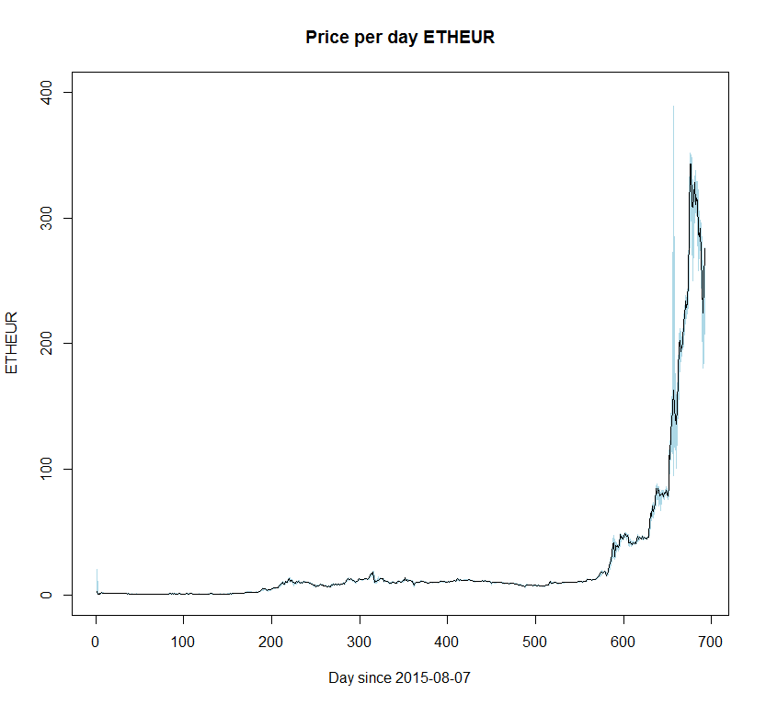

Data Set
Ethereum Exchange Rate
Time Period
Start: 2015-08-07
End: 2017-06-27
$C\left(t\right)=Closing price at time t (EURO)$

Slide 4

Predicting the Direction of Stock Market
Three classes: Lower, Equal, Higher
Labeling :
Formula: $Label= \left\{\begin{aligned}Higher if C\left(t\right)−C\left(t−1\right)> ε \\ Lower if C\left(t\right)− C\left(t−1\right)<−ε \\ Equal if \left|C\left(t\right)−C\left(t−1\right)\right|< ε \end{aligned}\right.$
$C\left(t\right)=Closing price at time t$
$ε=\frac{1}{8} of the standard deviation of C(t)$ $≈0.56 Euro$

Slide 5
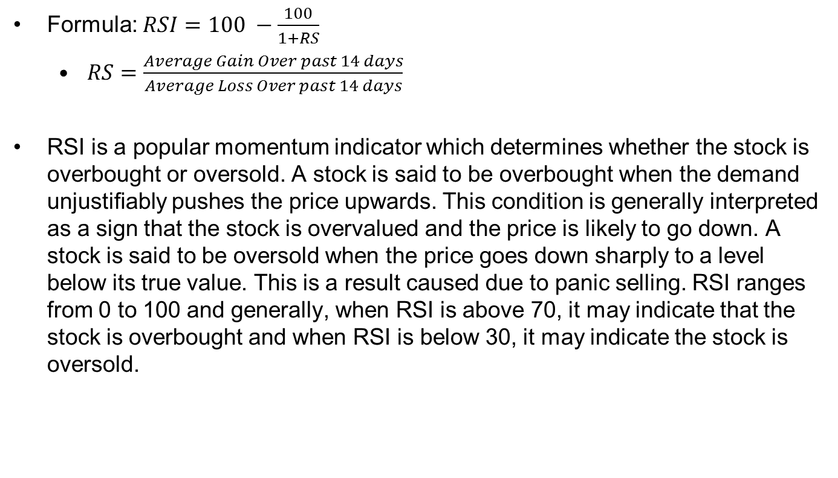
Relative Strength Index
Formula: $RSI=100 −\frac{100}{1+RS}$
$RS=$ $\frac{Average Gain Over past 14 days}{Average Loss Over past 14 days}$
RSI is a popular momentum indicator which determines whether the stock is overbought or oversold. A stock is said to be overbought when the demand unjustiﬁably pushes the price upwards. This condition is generally interpreted as a sign that the stock is overvalued and the price is likely to go down. A stock is said to be oversold when the price goes down sharply to a level below its true value. This is a result caused due to panic selling. RSI ranges from 0 to 100 and generally, when RSI is above 70, it may indicate that the stock is overbought and when RSI is below 30, it may indicate the stock is oversold.

Slide 6
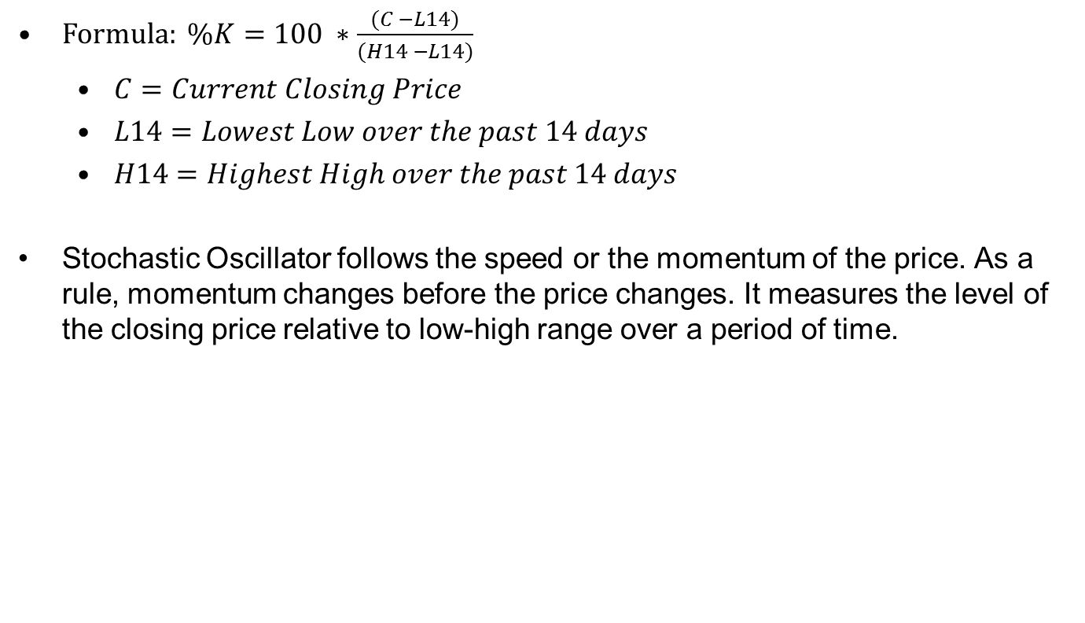
Stochastic Oscillator
$Formula: \%K=100 ∗\frac{(C −L14)}{(H14 −L14)}$
$C=Current Closing Price$
$L14=Lowest Low over the past 14 days$
$H14=Highest High over the past 14 days$
Stochastic Oscillator follows the speed or the momentum of the price. As a rule, momentum changes before the price changes. It measures the level of the closing price relative to low-high range over a period of time.

Slide 7

Williams %R
$Formula: \%R=\frac{(H14 −C)}{(H14 −L14)} ∗−100$
$C=Current Closing Price$
$L14=Lowest Low over the past 14 days$
$H14=Highest High over the past 14 days$
Williams %R ranges from -100 to 0. When its value is above -20, it indicates a sell signal and when its value is below -80, it indicates a buy signal.

Slide 8
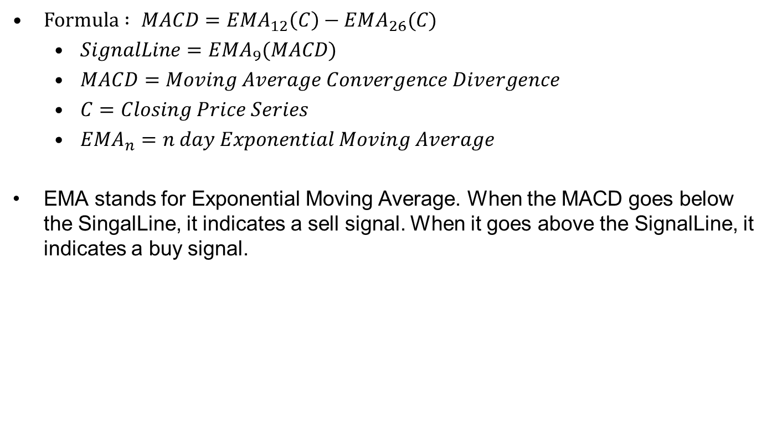
Moving Average Convergence Divergence
$Formula : MACD=EMA_{12}\left(C\right)−EMA_{26}(C)$
$SignalLine=EMA_{9}(MACD)$
$MACD=Moving Average Convergence Divergence$
$C=Closing Price Series$
$EMA_{n}=n day Exponential Moving Average$
EMA stands for Exponential Moving Average. When the MACD goes below the SingalLine, it indicates a sell signal. When it goes above the SignalLine, it indicates a buy signal.

Slide 9

Price Rate of Change
$Formula: PROC(t)=\frac{(C\left(t\right)−C\left(t−n\right))}{C(t−n)}$
$PROC\left(t\right)=Price Rate of Change at time t$
$C\left(t\right)=Closing price at time t$
$H14=Highest High over the past 14 days$
It measures the most recent change in price with respect to the price in n days ago.

Slide 10
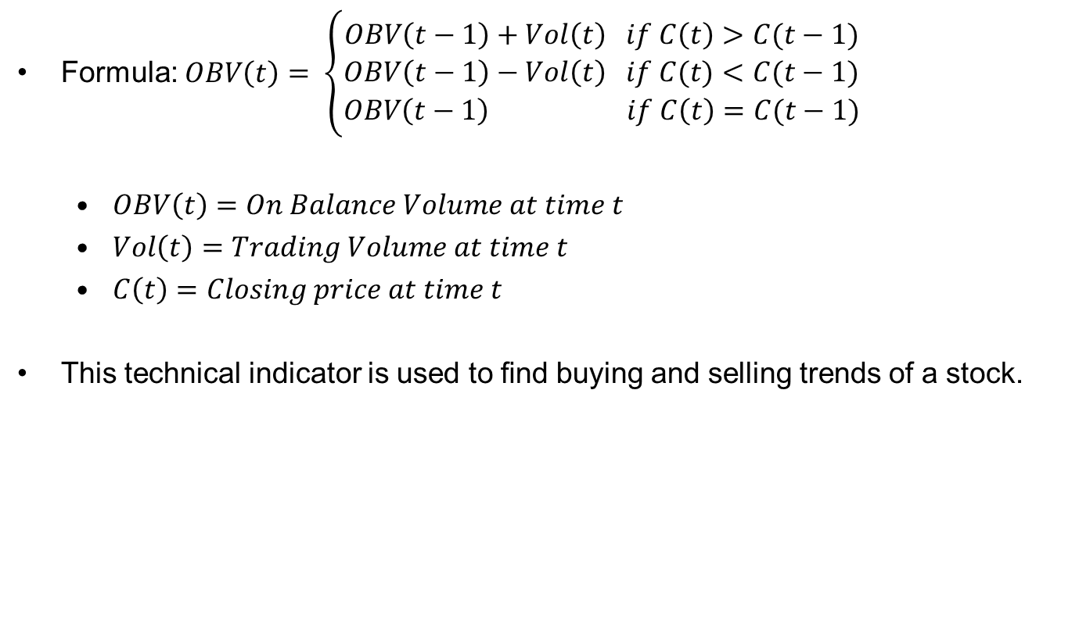
On Balance Volume
Formula: $OBV\left(t\right)= \left\{\begin{aligned}OBV\left(t−1\right)+Vol\left(t\right) if C\left(t\right)>C(t−1) \\ OBV\left(t−1\right)−Vol\left(t\right) if C(t)<C(t−1) \\ OBV\left(t−1\right) if C\left(t\right)=C(t−1)\end{aligned}\right.$
$OBV\left(t\right)=On Balance Volume at time t$
$Vol\left(t\right)=Trading Volume at time t$
$C\left(t\right)=Closing price at time t$
This technical indicator is used to ﬁnd buying and selling trends of a stock.

Slide 11
Literature
Khaidem, Luckyson, Snehanshu Saha, and Sudeepa Roy Dey. "Predicting the direction of stock market prices using random forest." arXiv preprint arXiv:1605.00003 (2016).

